Slide 1
Deep Learning

Slide 2
Deep Learning
A type of machine learning based on Artificial Neural Networks in which multiple layers of processing are used to extract progressively higher level features from data
Deep learning allows computational models that are composed of multiple processing layers to learn representations of data with multiple levels of abstraction

Slide 3
Practical Uses of Deep Learning
Computer Vision – Images are used to train the machine to recognize features and now the machines are demonstrating “superhuman” accuracy for image recognition.
Natural Language Processing – Modern deep learning techniques have led to improvements in translation and language modeling. Google Translate uses deep learning techniques to translate based on the semantics of an entire sentence instead of just memorizing phrase-to-phrase translations.
Automatic Speech Recognition – All major commercial speech recognition systems (think your smart phone assistant) use a deep learning technique with recurrent neural networks currently being the most popular.

Slide 4
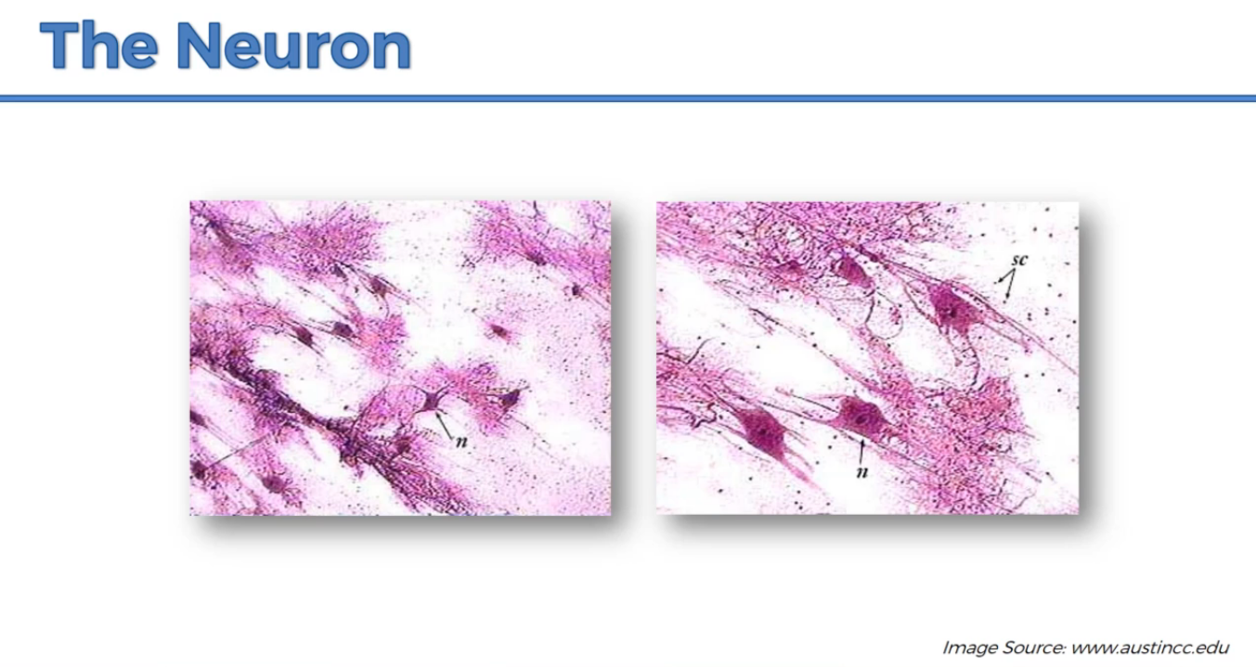

Slide 5
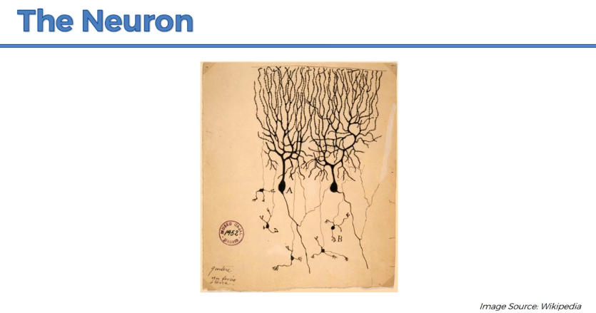

Slide 6
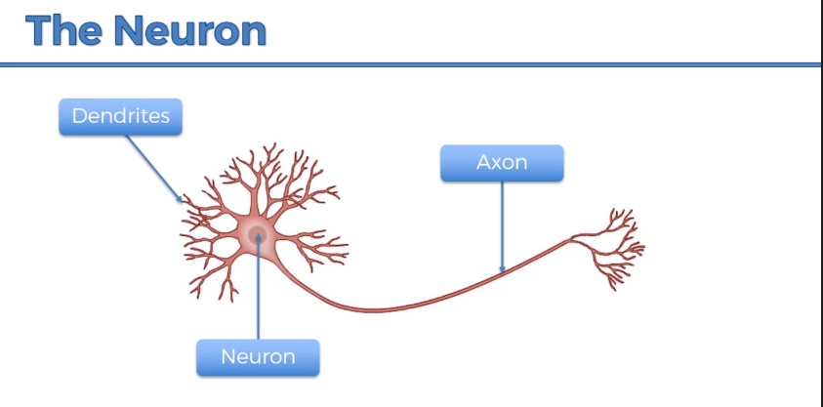

Slide 7
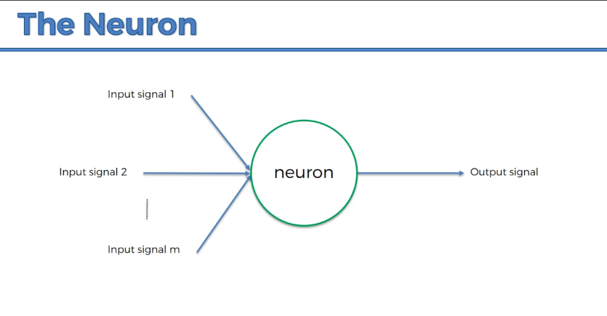

Slide 8
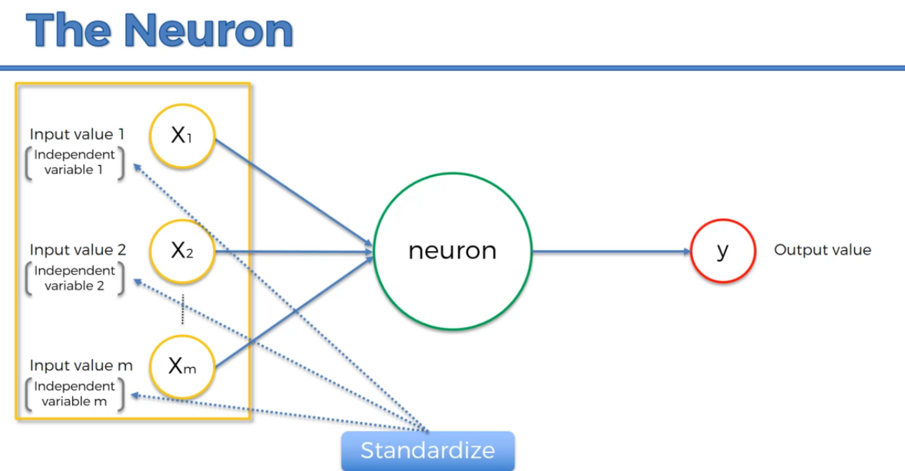

Slide 9
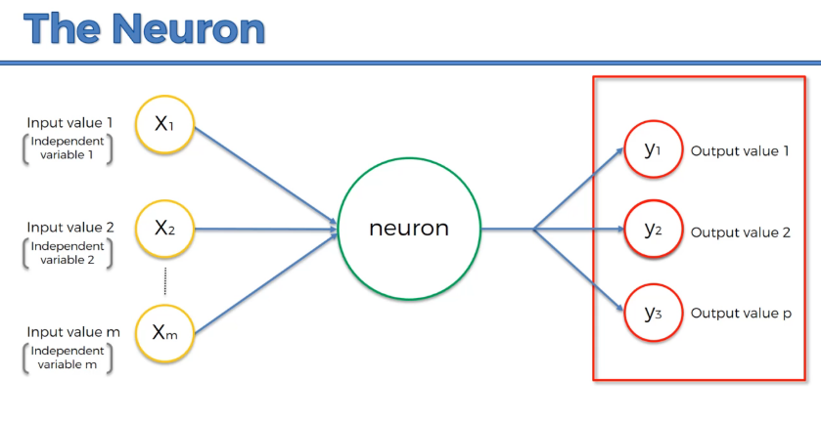

Slide 10
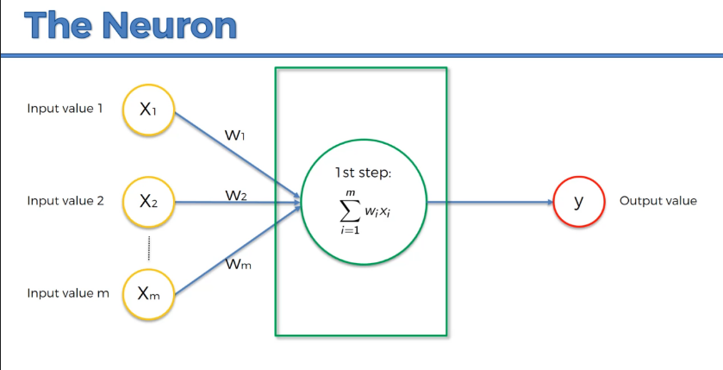

Slide 11
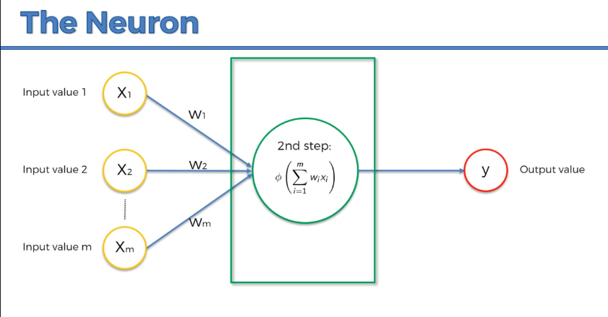

Slide 12
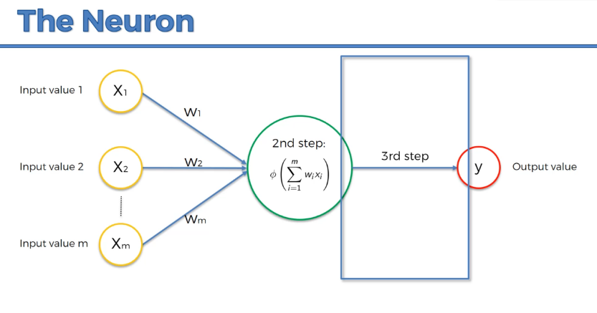

Slide 13
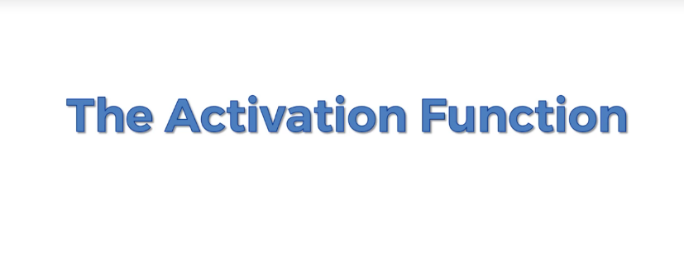

Slide 14
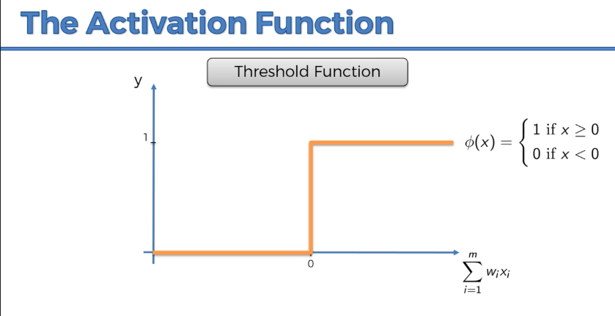

Slide 15
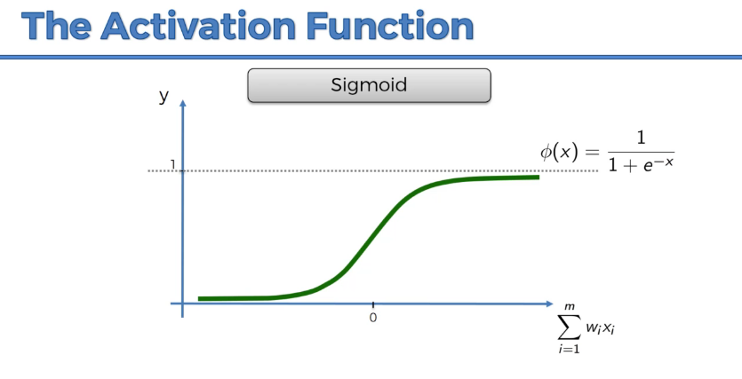

Slide 16
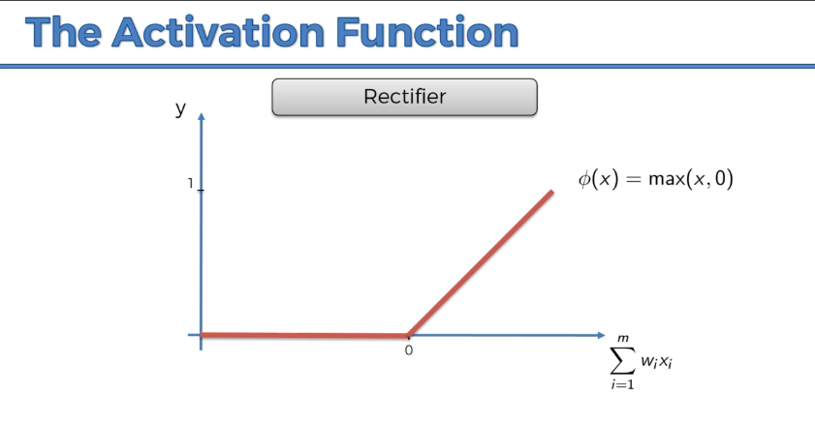

Slide 17
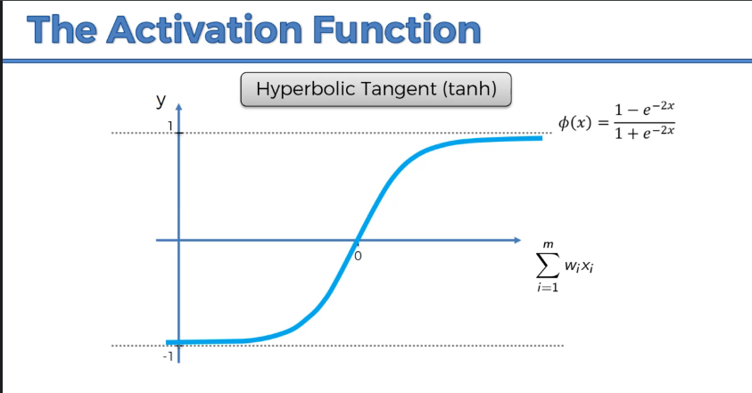

Slide 18
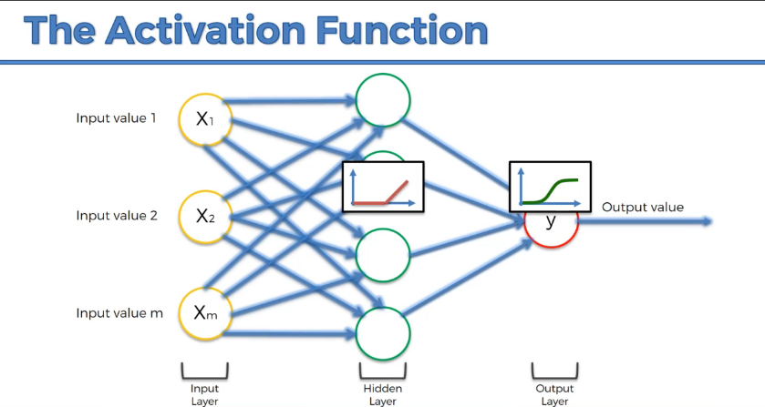

Slide 19
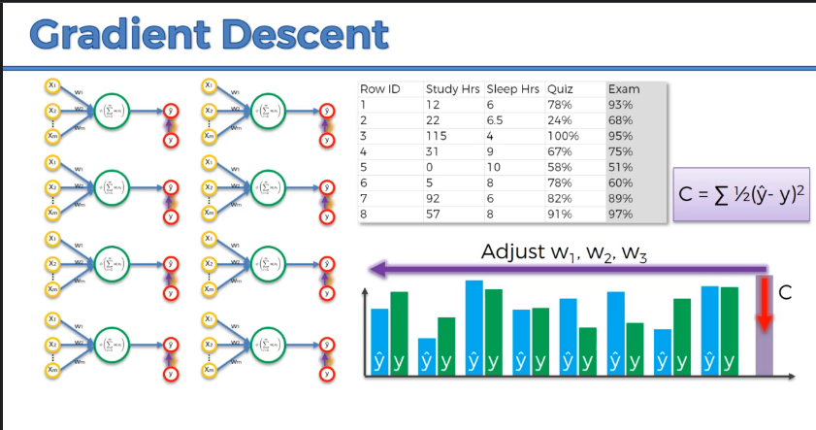

Slide 20
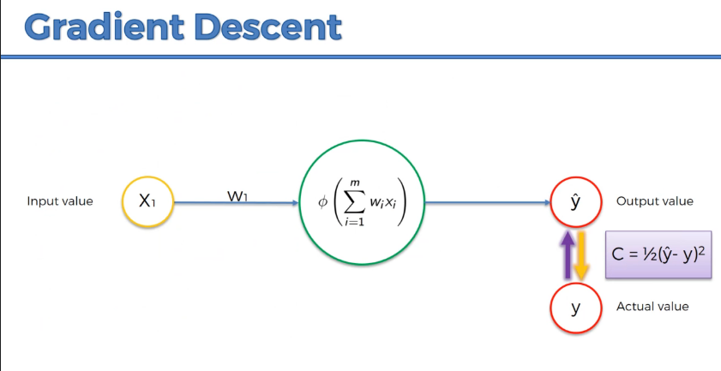

Slide 21
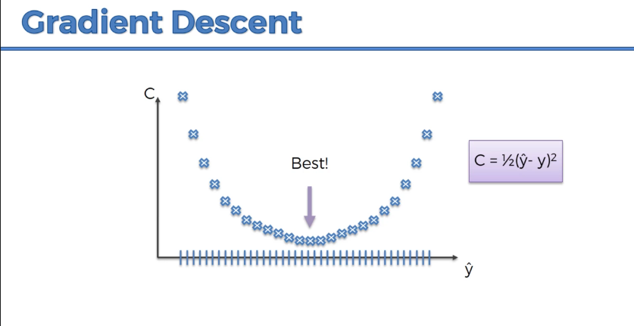

Slide 22
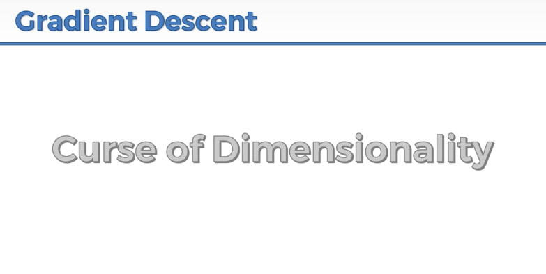

Slide 23
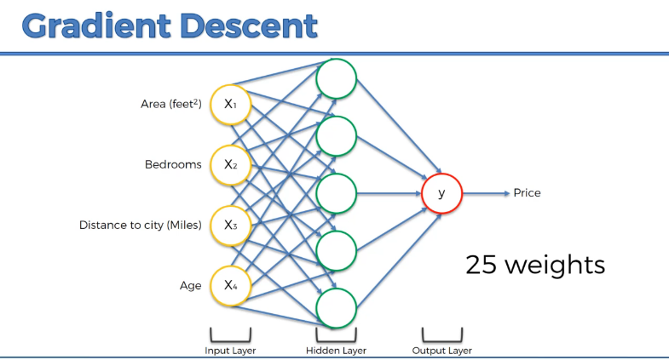

Slide 24
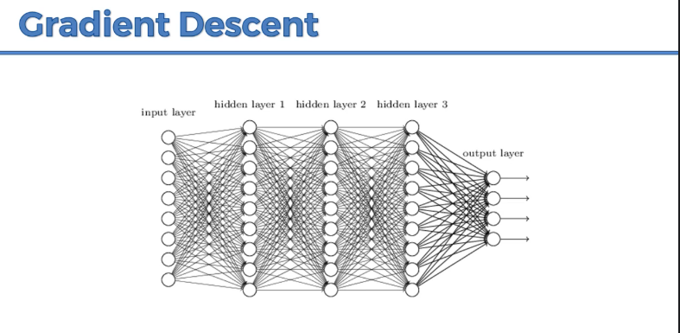

Slide 25
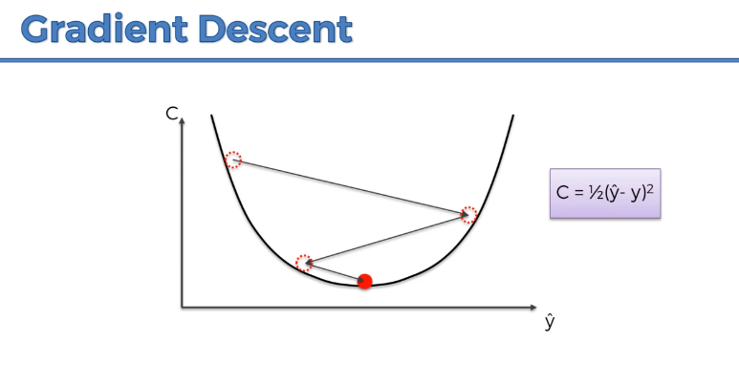

Slide 26
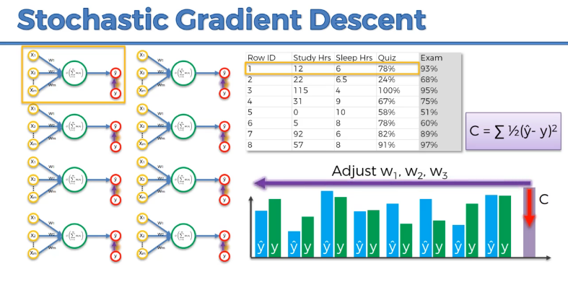

Slide 27
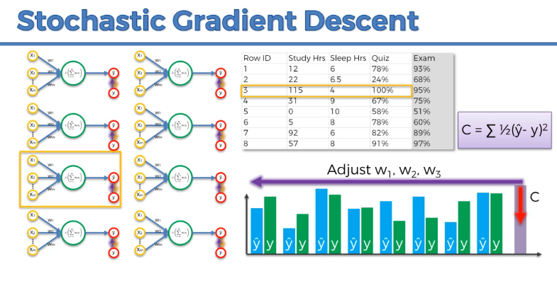

Slide 28
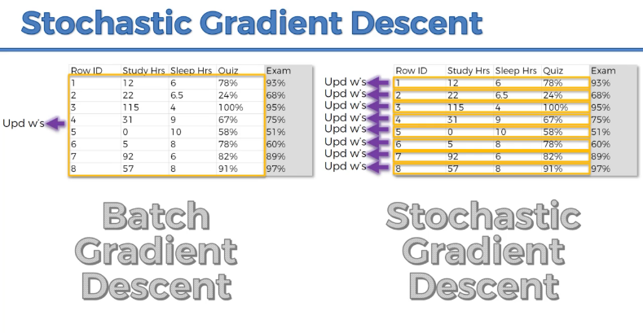

Slide 29


Slide 30
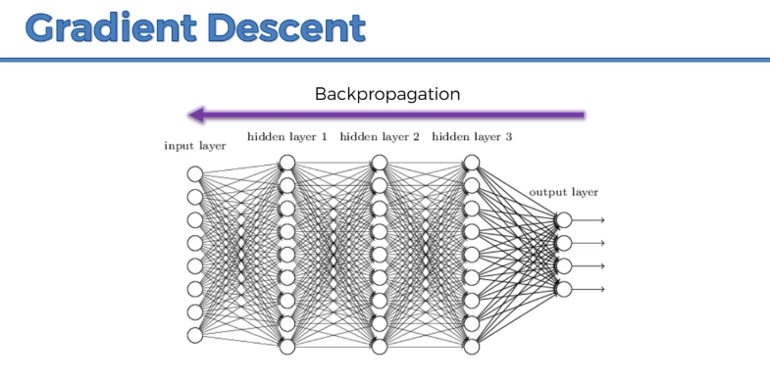

Slide 31
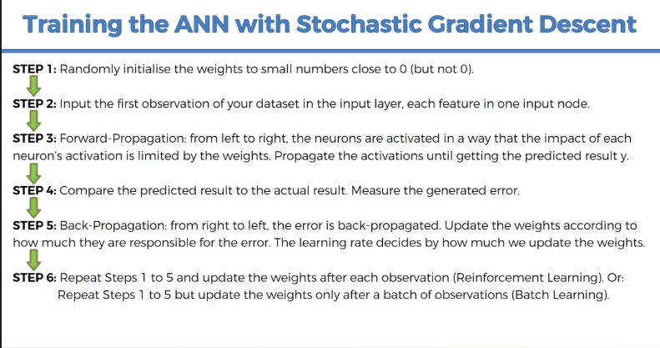

Slide 32
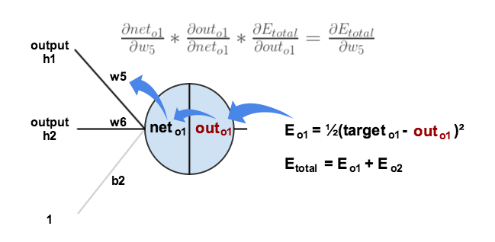

Slide 33
FLATTENING

Slide 34
